Slide 1
On or in? Where does atmospheric ice chemistry occur?
Sumi Wren
Tara Kahan

Slide 2
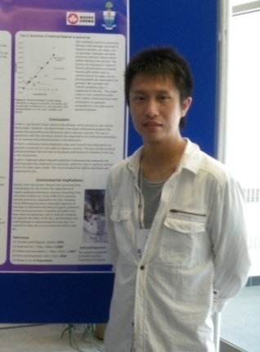
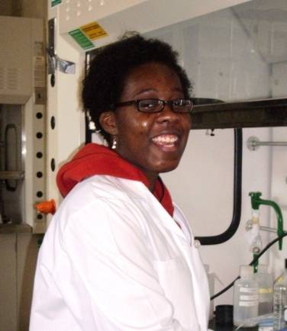
On or in? Where does atmospheric ice chemistry occur?
Thanks to:
Funding:
NSERC
CFCAS
Ran Zhao
Klaudia Jumaa
Nana Kwamena

Slide 3
(Uncomfortable) conclusions
Reactions within the ice matrix seem to be accurately modeled using aqueous parameters (if the correct concentrations are known)
Photolysis at the air-ice surface shows different kinetics from that within the ice matrix
Heterogeneous reaction kinetics at the air-ice interface may be quite different (or not!!) from those in the ice matrix
Exclusion of salts to the air-ice interface may be different from bulk thermochemical predictions
The air-ice interface presents a very different solvating environment from the liquid-air interface

Slide 4
I will discuss three kinds of experiment
Photolysis experiments using ice samples
Bimolecular reactions using ice samples
Exclusion of solutes and nature of the ice surface

Slide 5
In most laboratory experiments, reagents are frozen from solution and samples are melted prior to analysis
Often the kinetics may be well predicted from aqueous-phase results
Are kinetics measured in bulk ice indicative of reactivity in the QLL?
Potentially two regions of ice where reactions can occur
Reactivity may not be similar in both regions
Where does atmospheric ice chemistry occur?
nm scale
The QLL
mm scale
Ice matrix

Slide 6
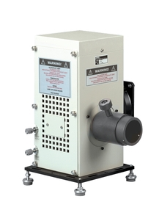
Example 1: direct photolysis of aromatic compounds
Anthracene
Analyse for reagents &
products using fluorescence,
HPLC, etc.

Slide 7
Aqueous solution
Ice cubes

Slide 8
Anthracene and naphthalene photolysis on ice: In situ measurements
liquid light guide
monochromator and PMT
oscilloscope
computer
Raman
/LIF
laser
Various wavelengths
< 3°
T.F. Kahan and D. J. Donaldson, J. Phys. Chem. A 111, 1277-1285 (2007)

Slide 9
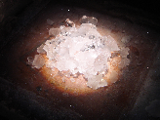

Slide 10
Anthracene photolysis in bulk samples
Aqueous solution
Ice cubes
Ice granules
Medium | k_{obs} (10⁻³ s⁻¹)
Bulk water | 0.25 ± 0.06
Air-water interface | 0.17 ± 0.03
Ice cube | 0.4 ± 0.2
Ice granule | 1.0 ± 0.3
Air-ice interface | 1.04 ± 0.08
T. F. Kahan et al, Environ. Sci. Technol., 44, 1303-1306 (2010)

Slide 11
A photolysis rate enhancement is observed
for harmine on the ice surface as well.
But on frozen salt solutions the rate reverts to
that seen on the water surface
In aqueous solution
T.F. Kahan et al.,
Atmos. Chem. Phys., 10, 10917-10922 (2010).
Exclusion of salts
during freezing creates
an aqueous brine
layer at the surface
On ice

Slide 12
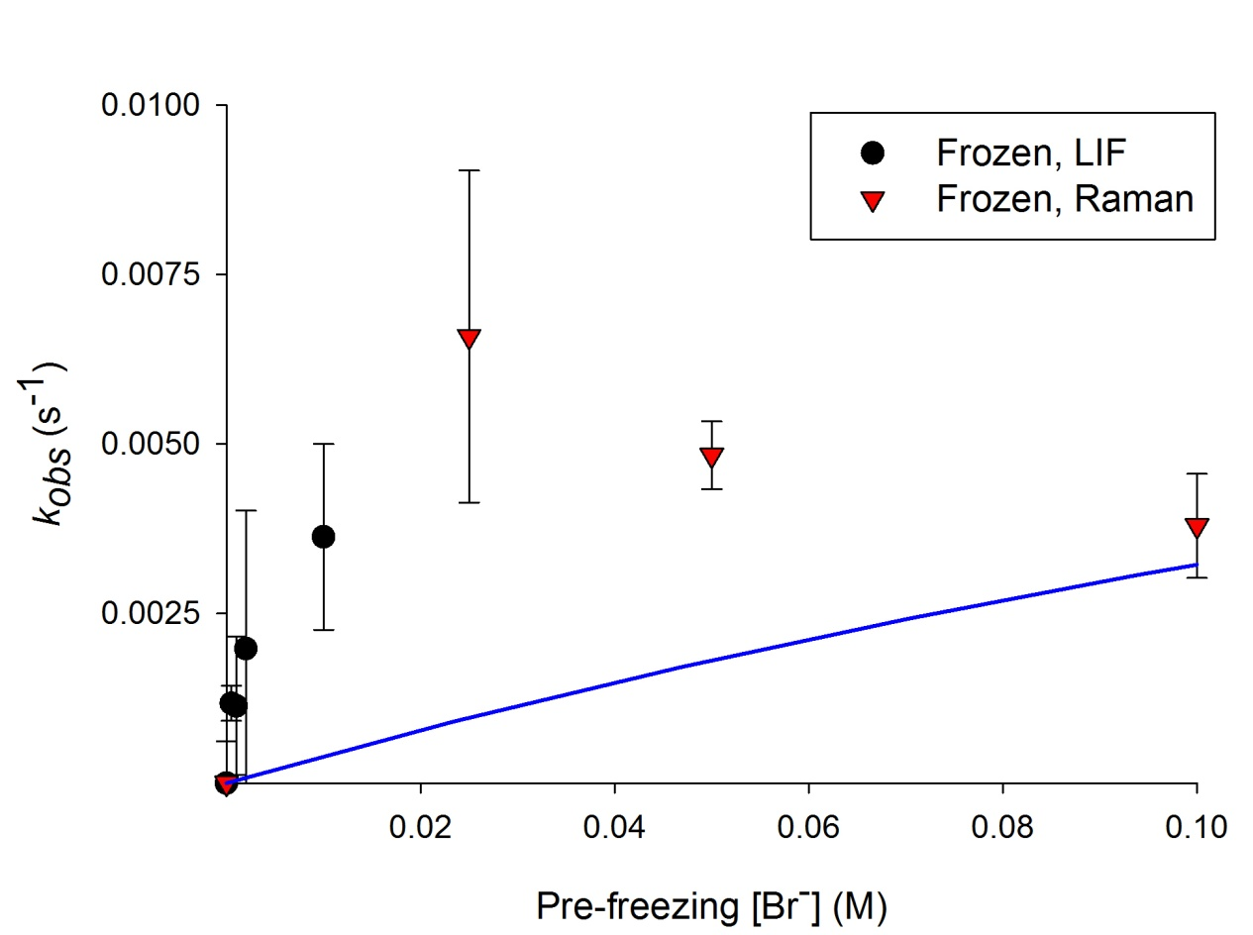
Example 2: oxidation at the air-ice interface
Kinetics of O₃(g) + Br⁻
Water surface result
S. N. Wren et al.,
J. Geophys. Res. 115 Article Number: D16309 (2010).

Slide 13
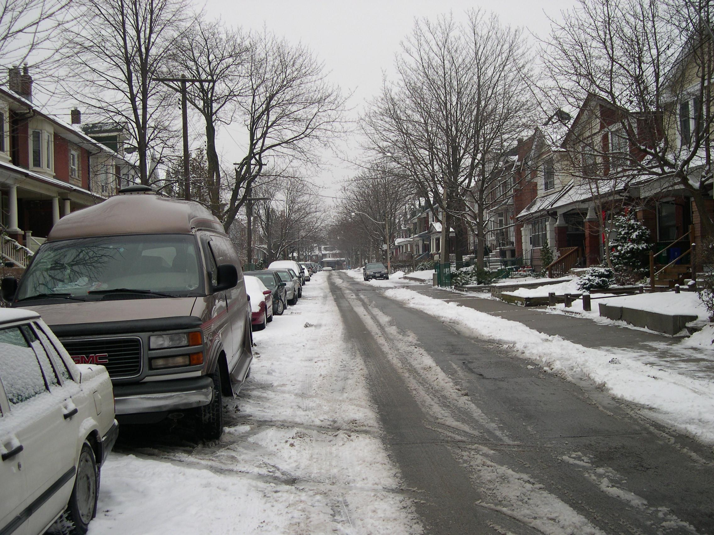
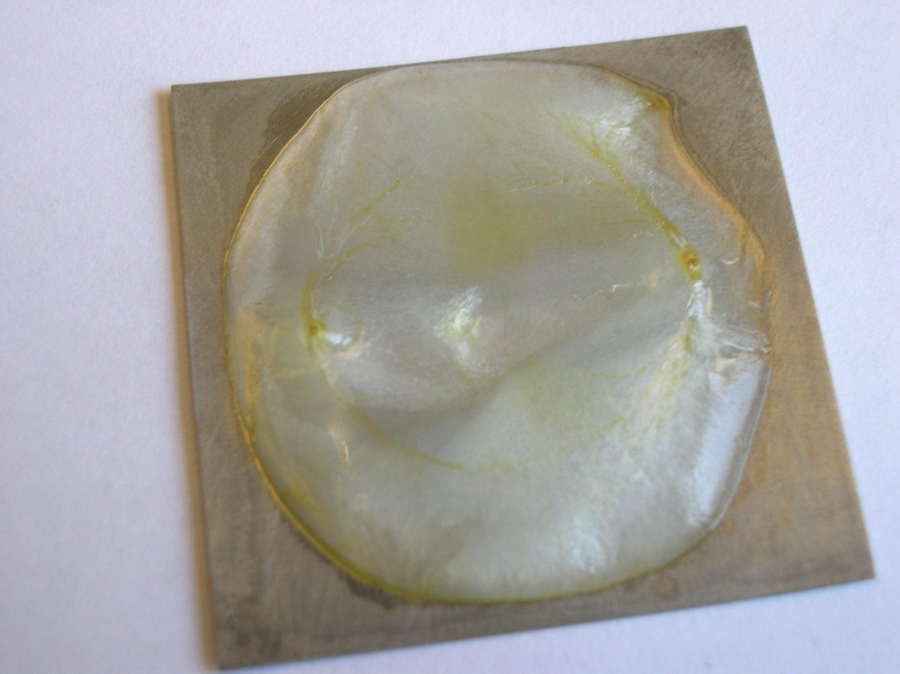
The much faster reaction rates on ice are best understood
as a consequence of salt exclusion during freezing,
yielding highly concentrated brines on the surface
T(°C)
Ion Exclusion
NaBr(aq) + H₂O(aq)
X⁻
X⁻
X⁻
X⁻
X⁻
X⁻
X⁻
0
NaBr(aq) + NaBr(s)
brine layer
-10
brine in liquid pockets
NaBr(aq) + ice
eutectic temperature
X⁻
-28
X⁻
ice and NaBr(s)
X⁻
ice matrix
mol fraction NaBr
Apparent saturation in kinetics, may be consequence of the [Xˉ] in the brine being independent of the initial solution [Xˉ]

Slide 14
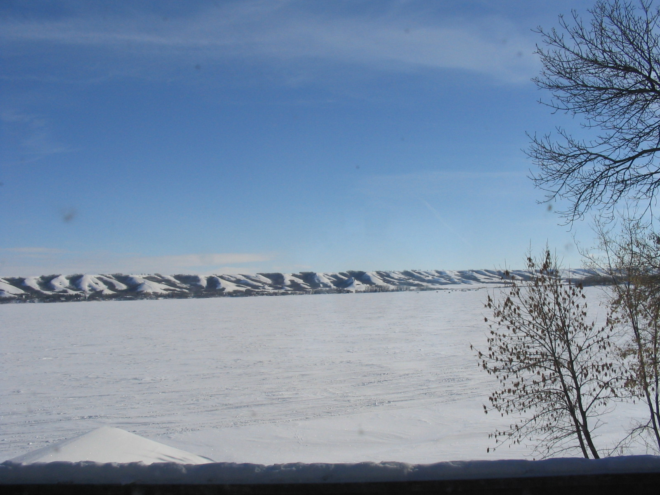
The loss kinetics of phenanthrene by ozonation at the air-ice
interface are (a) faster than in solution; (b) first order in
phenanthrene
Phenanthrene ozonation kinetics on ice
T. F. Kahan and D. J. Donaldson
Environ. Res. Lett. 3 045006
doi: 10.1088/1748-9326/3/4/045006 , (2008)
Ice, -11 ºC
Ice, -30 ºC
Medium | τ (days, 50 ppb O₃)
Gas phase¹ | 22
Organic film (surf)² | 44
Water (surf) | 44
Ice (surf, -11 ºC) | 5
Ice (surf, -30 ºC) | 5
Water surface (upper limit)
Kwok et al. Environ. Sci. Technol. 1994 28: 521
Kahan et al. Atmos. Environ. 2006 40: 3448

Slide 15
Reactions of OH with aromatics at the air-ice interface
Excitation spectra in aqueous solution
Irradiated sample
Phenol
OH formed from photolysis of H₂O₂, NO₃¯, or NO₂¯
Benzene + NaNO₂
Reagents frozen from solution or deposited from gas
Anthracene + OH
Benzene + OH → Phenol
Excitation spectra in aqueous solution
Phenol
Benzene
Phenol formation observed from the photolysis of OH-precursors in water, but not on ice
T.F. Kahan et al., Atmos. Chem. Phys, 10, 843-854, (2010)

Slide 16
Heterogeneous reactions of aromatics with OH(g) formed from HONO photolysis on water and ice surfaces
Benzene
Anthracene
Lamp on
Phenol formation on water
Ice surface
No phenol formation on ice
Water surface
T.F. Kahan et al., Atmos. Chem. Phys, 10, 843-854, (2010)

Slide 17
Once again, we do the ice cube and crushed ice experiments …
Phenol formation rates from OH + benzene in bulk samples
Ice cubes
Aqueous solution
Ice granules

Slide 18
How well are solutes excluded to the air-ice surface?
Kinetics of O₃ + Br⁻
Water surface result

Slide 19
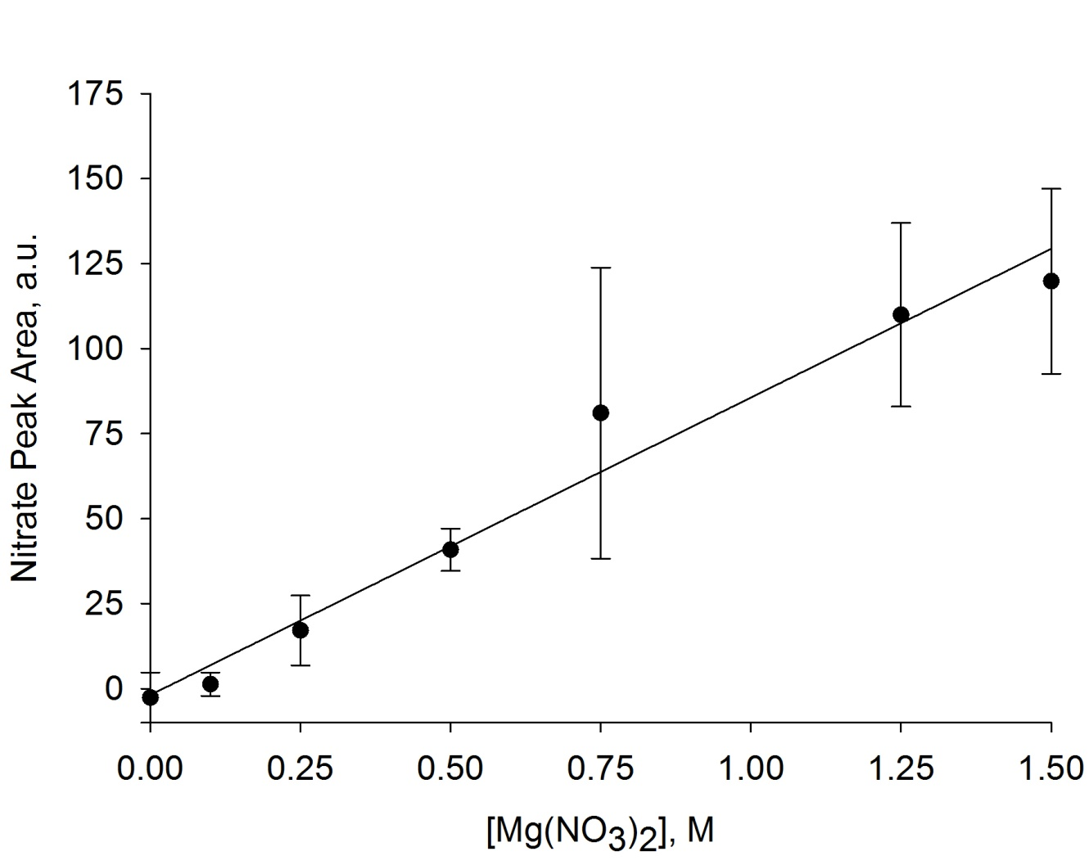
For nitric acid, NaNO₃ and Mg(NO₃)₂, we see a good Raman
signal from the nitrate sym. str. at the air-water interface
nitrate
H-O-H bend

Slide 20
Now with some understanding of nitrate intensities, we freeze
100 mM solutions of Mg(NO₃)₂

Slide 21
Mg(NO₃)₂·H₂O Phase Diagram
T (°C)
Liquid
Mg(NO₃)_{2(aq)} + H₂O_{(aq)}
-10 °C
Two Phases
Mg(NO₃)_{2(aq)} + H₂O_{(s)}
Eutectic T
Solid
Mg(NO₃)₂·9H₂O_{(s)}
Mg(NO₃)₂ wt %
Brine [Mg(NO₃)₂]
19 wt% ≅ 1.3 M Mg(NO₃)₂
≅ 2.6 M NO₃ˉ

Slide 22
Mg(NO₃)₂·H₂O Phase Diagram
T (°C)
1.5 M
-10
0.5 M
Mg(NO₃)₂
wt %
Brine [Mg(NO₃)₂]
19 wt% ≅ 1.3 M Mg(NO₃)₂
≅ 2.6 M NO₃ˉ
Surface [NO₃ˉ] not predicted by equilibrium phase diagram
Nitrate must be excluded to liquid pockets or incorporated into ice matrix
Not consistent with our previous work on halide ozonation at the ice surface

Slide 23
Does the absorption spectrum and/or the photolysis quantum yield change in the QLL?
Naphthalene fluorescence in hexanes at 77 K
Naphthalene Emission
Water
Ice
Kawakubo et al. J. Phys. Soc. Japan 1966 21: 1469
Red-shifts in emission spectra on ice indicate self-association:
This is observed for naphthalene, anthracene, phenanthrene, benzene and phenol ... Whether aromatic is frozen from solution or deposited from the gas phase and at all concentrations studied

Slide 24
Molecular dynamics simulations
show that aromatics on ice
surfaces are not as well solvated
by the water molecules present
there as on the liquid surface due
to the fewer “free” OH at ice
surface. This feature is observed
also in the Raman spectrum of
surface water vs. ice.
Thus the aromatics tend to
self-associate at the ice surface
to lower their energies there.

Slide 25
For naphthalene, the “self-associated” absorption is shifted to the red ... into the actinic region
Naphthalene absorption
Aqueous solution
Solar output
Air-ice interface
Crystalline
Monomer
Thus self-association on ice could contribute to enhanced naphthalene photolysis kinetics
Bree and Thirunamachandran Molec. Phys. 1962 5: 397

Slide 26
Benzene photolysis on ice shows a similar enhancement ... and a similar red shift in absorption
Benzene excitation spectra
Benzene photolysis kinetics
Water
Ice
Solar output
Water
Ice

Slide 27
(Uncomfortable) conclusions
Reactions within the ice matrix seem to be accurately modeled using aqueous parameters (if the correct concentrations are known)
Photolysis at the air-ice surface shows different kinetics from that within the ice matrix
Heterogeneous reaction kinetics at the air-ice interface may be quite different (or not!!) from those in the ice matrix
Exclusion of salts to the air-ice interface may be different from bulk thermochemical predictions
The air-ice interface presents a very different solvating environment from the liquid-air interface

