Slide 1



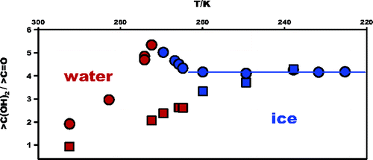
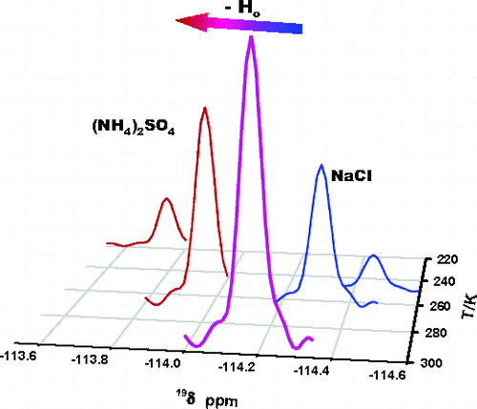
Third Workshop on Air-Ice Chemical Interactions
Columbia University, New York, June 6, 2011
A Photochemical Mechanism of Model Organic Matter in Ice
Marcelo I. Guzman¹ and Michael Hoffmann²
¹Department of Chemistry, University of Kentucky, Lexington, Kentucky, USA
²Environmental Science & Engineering, Caltech, Pasadena, California, USA
Email: marcelo.guzman uky.edu
Notes:
Part 1 Opener

Slide 2
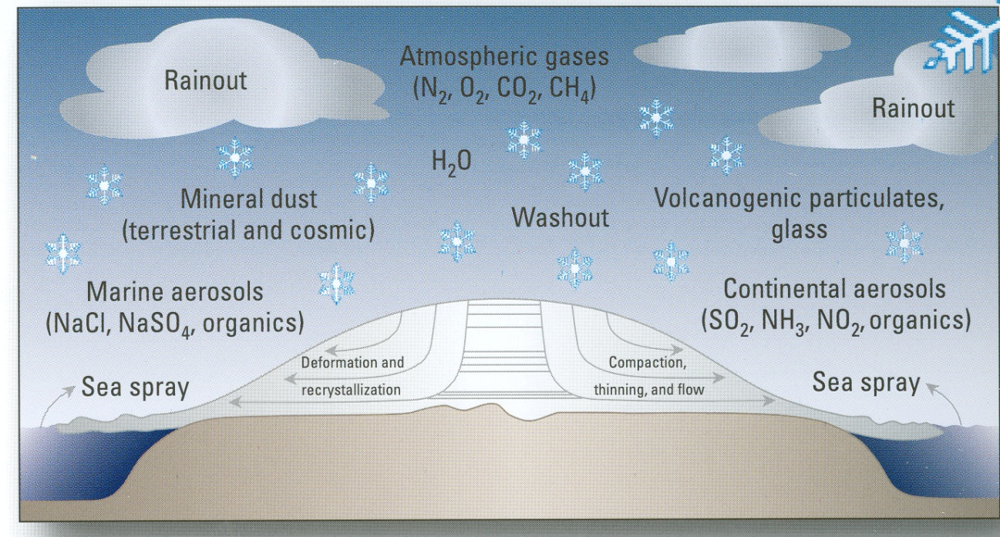
Relevant Processes in the Polar Environment

Slide 3

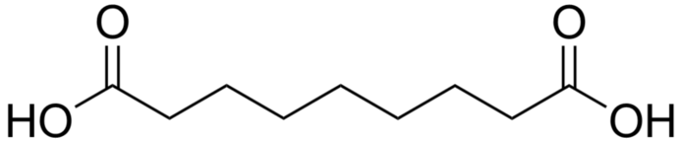
Boreal forest fires
What organics are found in in glacial ice?
natural waters
Aromatic, ~ 450 Da
Organic Macromolecules
atmospheric aerosol
snowpacks
Aliphatic, <1000 Da
Grannas (2007) Atmos Chem Phys 7, 4329
A Greenland Ice Core Record
Dicarboxylic Acid: [Azelaic] (C9) 0.64 ng/g (MW: 188)
α-Ketocarboxylic Acid: [Pyruvic] 0.23 ng/g (MW: 88)
Kawamura et al. (2001) JGR 106, 1331
Abundance in the fine (< 2 μm) Arctic aerosol samples between January and April:
Kawamura et al. (2005) Atmos Environ 39, 599
Goal: Photodecarboxylation mechanism in ice
φ_{ice} / φ_{fluid} = ?

Slide 4
Organic Chromophores?
Only dicarbonyl chromophores absorb at >300 nm…in the gas-phase
However, in water most dicarbonyls exist as gem-diols…
Certain carbonyls absorb in water in the UV, Pyruvic acid: 35% carbonyl form at 300 K
UV Spectra of Organic Acids
Lund et al., Atmos. Chem. Phys. (2004), 4, 1759.
www.guzmanlab.com
Marcelo I. Guzmán, University of Kentucky

Slide 5
Frozen Aqueous Solutions
NMR image of a sample of ice The sample diameter is 15 mm
> 99.9 % of the solutes accumulate in the unfrozen portion
selective incorporation of some ions
transient electrical potential
Menzel et al., (2000) J. Mag. Res.
interfacial proton migration
concentration effects
Reaction rates and equilibrium in frozen solutions
low temperatures
acidity changes
Robinson et al. (2006) J. Phys Chem B, 110, 7613
Grannas et al., (2007) J. Phys Chem A, 111, 11043
Heger et al., (2004) J Phys Chem A, 109, 6702
Guzman et al. (2006) J. Phys. Chem. A, 110, 931
Kahan et al. (2007) J Phys Chem A, 111, 11006
Angell, C. A. In Water, a comprehensive treatise; Franks, F., Ed.; Plenum: New York, 1982; Vol. 7

Slide 6
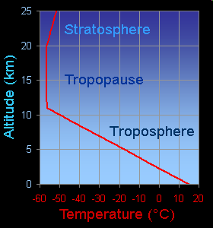
Aerosol-like Conditions
Assume 50% RH: 1 g NH₄HSO₄ / 0.6 g H₂O
1 - 10 mg Pyruvic acid/g Sulfate
⇓
0.02 M to 0.2 M PA
> 300 nm
F_{Lamp} = 6 to 48 × 10¹⁴ photons cm⁻² s⁻¹
1 atm air or 1 atm N₂ or 1 atm O₂
This work: 5 to 200 mM
 F_{sun} 6 × 10¹⁵
www.guzmanlab.com
Guzman et al. (2006) J. Phys. Chem. A, 110, 3619

Slide 7
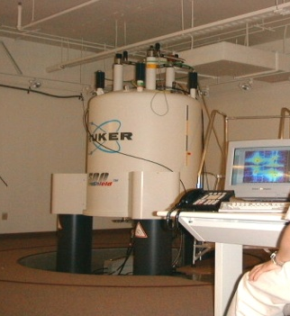
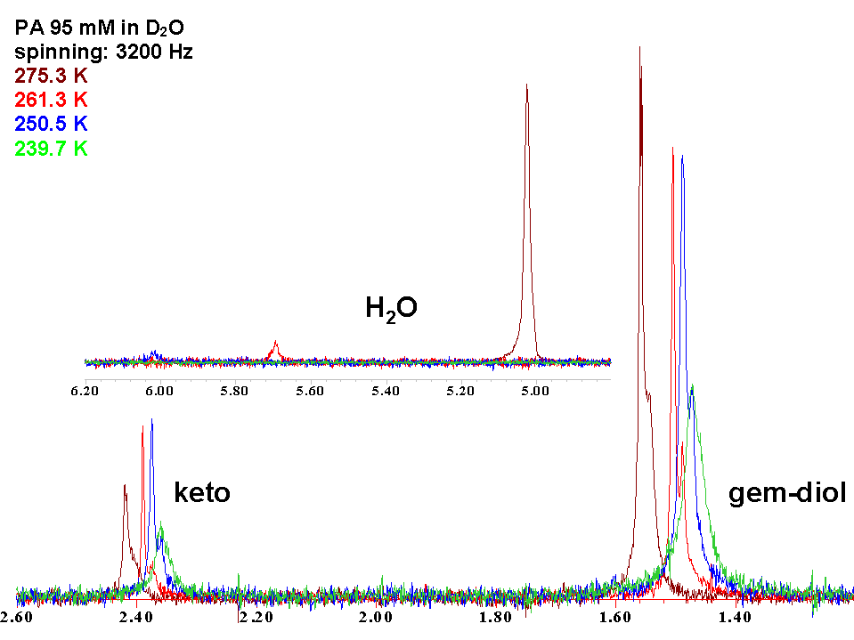
Frozen Aqueous Pyruvic Acid Solutions:
Q_{H} = [PAH] / [PA]
Number of water molecules involved at 293 K: n₀  1 and n₁  7
Probe of water availability in frozen media
20% pyruvic acid is present as a carbonyl down to -35 ºC
Measurement Technique: Solid-State MAS NMR
www.guzmanlab.com
Guzman et al. (2006) J. Am. Chem. Soc. 128, 10621

Slide 8
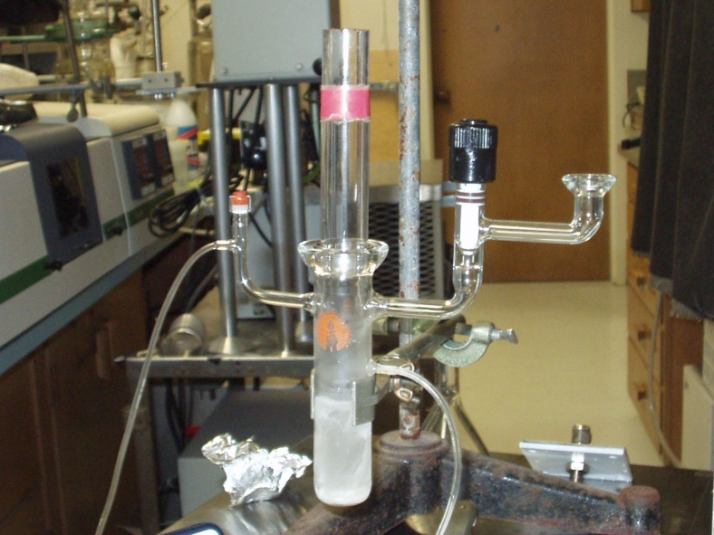
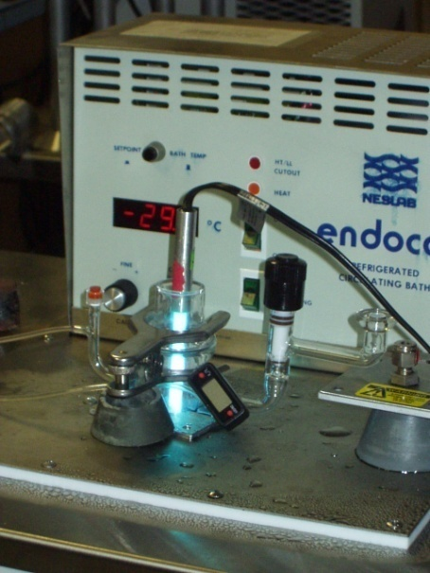
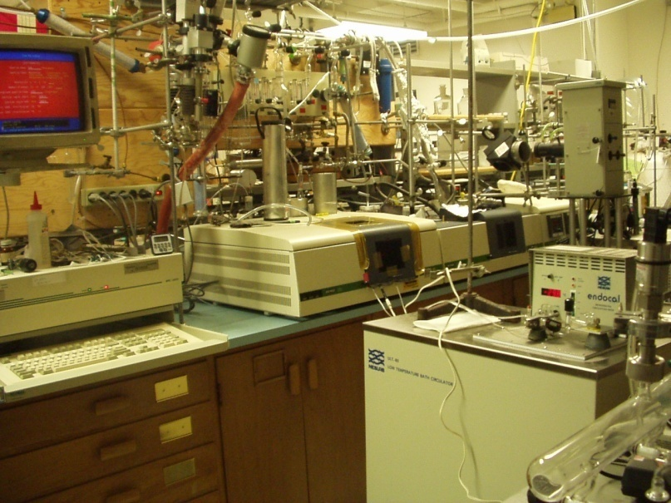
Experimental Setup
Reaction products?
Mechanism?

Slide 9
Photogeneration of Distant Radical Pairs in Frozen Pyruvic Acid Solutions
Recombination?
Ruzicka at al. (2005) J. Phys. Chem. B, 109, 9346
Evolution of CO₂ during the 313 nm photolysis of frozen PA solutions
Guzman et al. (2006) J. Phys. Chem. A, 110, 931
www.guzmanlab.com

Slide 10
Photochemistry of Pyruvic Acid in Ice
CO₂ evolves during & after irradiation. Post-irradiation CO₂ increases with rate constants k_{D}(T)
[CO₂] = A + B [1 - exp(- k_{D} × time)]
Thermodynamics of CO₂ Release
turn-off light
ΔH = 6.44 kJ/mol
Guzman et al. (2007) J. Geophys. Res., 112, D10123

Slide 11
Post-irradiation CO₂ Release
turn-off light
Photolysis at λ = 313 nm:
    PA 60 min hν
    BF 15 min hν
Turn-off light
Observe CO₂ release vs. time
Pyruvic Acid (PA) photoproduct D thermally releases CO₂ in a reaction impeded by the ice matrix
Guzman et al. (2007) J. Geophys. Res., 112, D10123

Slide 12
Activation Energy (E_{a,D}) for Thermal CO₂ Release of Species D
Photolysis of frozen 0.1 M PA at constant T and λ = 313 nm
Turn-off light after 60 min
Measure k_{D} for thermal CO₂ release
Plot k_{D} vs. 1/T between
227 K < T < 268 K
log (k_{D}/s⁻¹) = 1.08 -1191/T
E_{a,D} = 22.8 kJ/mol in ice (96 kJ/mol @ 298 K) vs. H-bond in ice: ~21 kJ/mol
A_{D}-factor = 12.1 s⁻¹ (1.7  10¹³ s⁻¹ @ 298 K)
Photoproduct D thermally releases CO₂ in a reaction impeded by the ice matrix
Guzman et al. (2007) J. Geophys. Res., 112, D10123

Slide 13
Product Analysis
3
4
7
ESI MS (-)
Intensity
(a.u.)
HPLC ESI MS (-)
Retention time (min)
Absorbance/10⁻³
Relative Abundance
UV SPECTRA
¹³C NMR SPECTRA
Ethers Kimura
δ (ppm)
Guzman et al. (2006) J. Phys. Chem. A, 110, 3619
m/z⁻

Slide 14
B is favored in:
1) higher [PA]_{o} (fluid solutions), or
2) the concentrated nanoscopic environments in ice
5 to 200 mM
Reaction Mechanism
Guzman et al. (2006) J. Phys. Chem. A, 110, 3619;
(2007) J. Geophys. Res., 112, D10123
Notes:
The production of B was favored in the concentrated nanoscopic environments in ice in agreement with the observation that the branching ratio for this species increase for higher pyruvic acid concentration in fluid solutions relative to the production of A.

Slide 15
Quantum Yields for the Overall CO₂ Production in Fluid and Frozen Solutions
Solution @ 293 K:
Frozen < 270 K:
Log φ(CO₂) = 0.81 - 338/T @ T < 270 K
Guzman et al. (2007), J. Geophys. Res., 112, D10123

Slide 16
A Natural Experiment for the Photo-production
of CO and CO₂ in Ice
(▼) ΔCO₂ and (Δ) ΔCO mixing ratios between Greenland (GRIP and Eurocore) and Antarctic (Vostok) ice core records versus mean gas age
S(CO₂)/S(CO) ~ 200
Photolysis of dissolved organic matter in surface ocean waters: φ(CO₂)/φ(CO) ~ 50
Guzman et al. (2007), J. Geophys. Res., 112, D10123

Slide 17
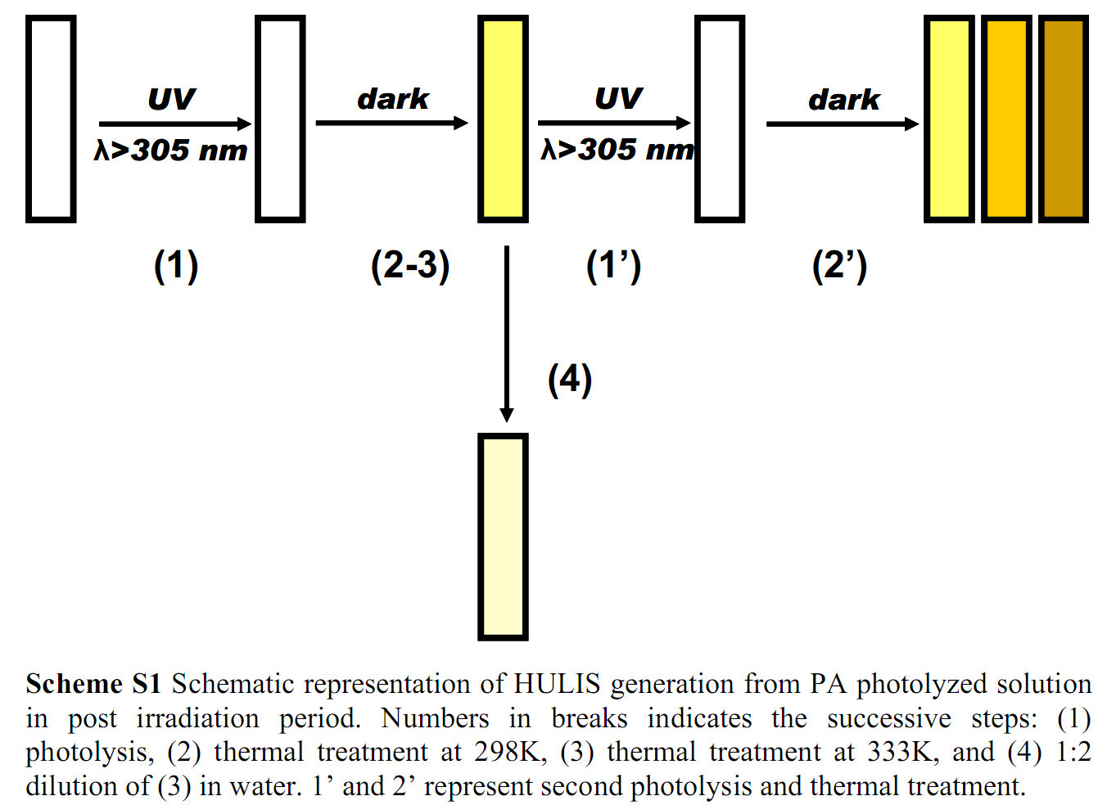

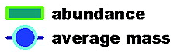
Photochemistry of Model Organic Matter
Area under the fluorescence
emission curves peak at 350 nm
Total ion abundance & average ion mass
J. Phys. Chem Lett., 2010, 1, 368
Rincon et al., (2009) J Phys Chem A, 113, 10512

Slide 18
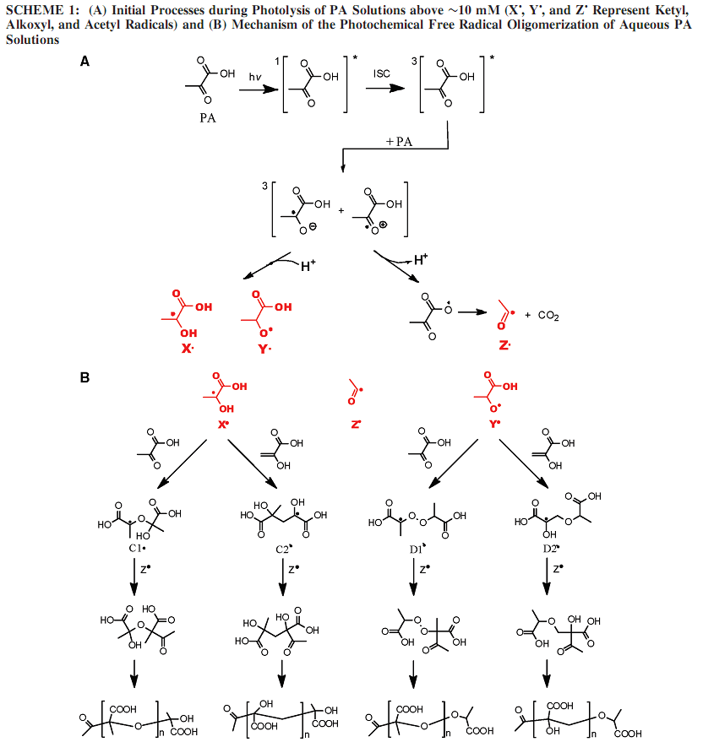
Mechanism of Polymerization
Initial Processes During Photolysis, [Pyruvic Acid] > 4 mM
Mechanism of the Photochemical Free Radical Oligomerization of Aqueous Pyruvic Acid Solutions
Ketyl
Acetyl
Alkoxyl
Guzman, et al.,
(2006) J Phys Chem A, 110, 931
(2006) J Phys Chem A, 110, 3619
Rincon, et al.,
(2009) J Phys Chem A, 113, 10512
(2010) J Phys Chem Lett, 1, 368
www.guzmanlab.com

Slide 19
Conclusions
Method to quantify carbonyl concentrations in ice (20% for PA)
Carbonyl hydration in frozen solutions
Identification of radical pairs intermediates and reaction products in water and ice
Reaction mechanism in ice
Quantum yields in ice
Ice core records implications
HULIS

Slide 20

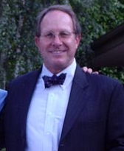
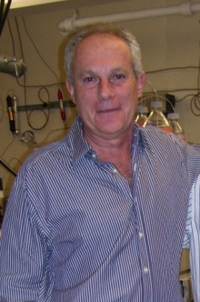
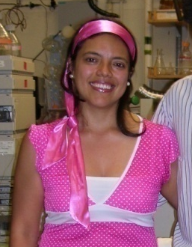


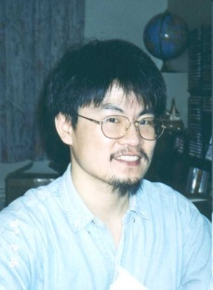
Acknowledgments
Angela Rincon
University of Cambridge
Michael Hoffmann
Caltech ESE
A. J. Colussi
Caltech ESE
N. Dalleska
Caltech Environmental
Analysis Center
S. Hwang
Caltech Solid State
NMR facility
Paul Wennberg
John Seinfeld
Richard Flagan
Angelo Di Bilio
www.guzmanlab.com

Slide 21
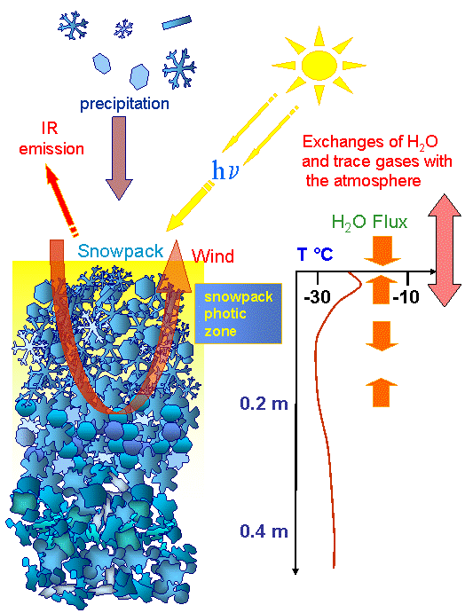
CO production versus the time in liquid phase (solid line) or in solid phase at −20°C (dashed lines). Curves 1, 2, 3, 4 respectively correspond to the following samples: Eurocore (104 m); Eurocore (211.35 m); Vostok BH3 (108.6 m) and artificial gas-free ice. Curve 5 corresponds to the same test as curve 2 except that the meltwater was irradiated by UV for 1 hour 30.
CO, formaldehyde and acetaldehyde are produced upon irradiation of snow
Haan et al., (1998) Tellus 50 B 253
Grannas and Shepson, (2004) BGC
Domine and Shepson (2002) Science, 297, 1506
From Haan et al., Tellus (1998) 50 B, 253

Slide 22
Pyruvic Acid Concentration Effects
Previous studies: subμM < [PA] < mM at pH 8.2
I_{a} = I₀ [1 – exp(-2.303 ε l C)]
For [PA] < 4 mM the formation rate of products generated in the unimolecular decomposition of ³PA* increase linearly with [PA] (φ  f[PA])
Kieber and Blough, (1990) Free Radical Res. Commun., 10, 109

Slide 23
Pyruvic Acid Concentration Effects
conditions: assume a_{w}= 0.5
0.6 g H2O/1 g NH₄HSO₄
1 - 10 mg Pyruvic acid/g Sulfate ⇒ 0.02 M to 0.2 M PA
K = 158 mM
Mechanism involves a bimolecular initiation process!
Guzman et al. (2006) J. Phys. Chem. A, 110, 3619

Slide 24
CO₂(g) released during irradiation of frozen, deareated aqueous PA (100 mM) doped with TEMPO at 253 K. (▲) without TEMPO; (▼) [TEMPO] = 0.25 mM; (●) [TEMPO] = 1.00 mM; (■) [TEMPO] = 2.40 mM

Slide 25
Quantum Yields for the overall CO₂ production in frozen solutions
Solution < 270 K
Frozen: Log φ(CO₂) = 0.81 – 338/T @ T < 269 K

